Slide 1


Predicting Mental Distress
Understanding challenges for older adult women
Sona Guliyeva
Under the mentorship: Ricardo Alanis
For the course: Data Science Career Track

Slide 2
The Problem
Older adults face significant mental health challenges, particularly Frequent Mental Distress (FMD), which impacts their quality of life and requires immediate attention.
Mental Health Challenges
Definition of FMD
Project Goals
A growing concern for older adults, mental health issues often go undiagnosed and untreated.
Frequent Mental Distress is characterized by experiencing mental health issues multiple times a month affecting daily functioning.
This project aims to identify predictors of FMD and develop a model to provide actionable insights for mental health interventions.

Slide 3
Project Objectives
The aim is to uncover underlying factors related to Frequent Mental Distress among older women and create a model that predicts outcomes based on these factors.
Identify Predictors
Build Model
Interpret Results
Explore various factors influencing mental distress, including demographics and health metrics, to determine key predictors.
Develop a predictive model using statistical techniques, ensuring it is robust and reliable through validation processes.
Analyze outcomes for actionable insights, allowing stakeholders to implement targeted interventions and support for older adult women.

Slide 4
Data Source
The Behavioral Risk Factor Surveillance System (BRFSS) provides crucial data for analyzing mental distress among older adults in the U.S.
Dataset Size
Columns Overview
Missing Values
The initial dataset comprises over 400,000 responses collected from adults aged 50 and older.
Key columns include demographics, health behaviors, and mental health indicators relevant to our analysis.
Challenges arose due to significant missing values, requiring detailed imputation strategies for accurate analysis.

Slide 5
Data Wrangling
Data wrangling is a crucial step in preparing our dataset for analysis, ensuring accuracy and relevance for predictive modeling in mental health.
Filtering Data
Preprocessing Steps
Final Dataset Size
We removed irrelevant columns and rows that did not contribute to our analysis.
Data was standardized and normalized for consistency before modeling to enhance predictive accuracy.
After filtering and preprocessing, our dataset consisted of 5,000 relevant entries ready for analysis.

Slide 6
Exploratory Analysis
This section analyzes the target variable, Frequent Mental Distress (FMD) prevalence, and the key patterns observed in the data visualizations.
Target Variable
FMD Prevalence
Key Patterns
The target variable is Frequent Mental Distress, which measures the emotional wellbeing of older adult women.
The prevalence of FMD among older adults shows significant variations based on various demographic factors.
Key patterns reveal insights into self-rated health, social factors, and their correlation with mental distress levels.

Slide 7
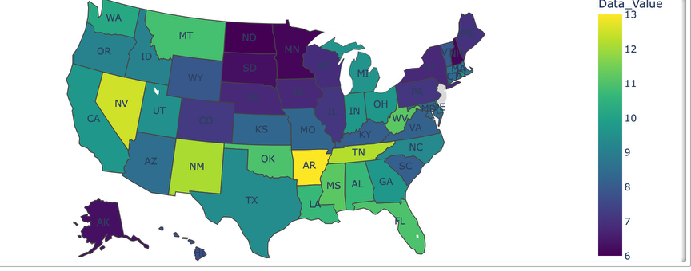
Geographic Patterns in Mental Distress
A choropleth map was created to visualize the average frequent mental distress values by state for the target population group.
Observations:
Substantial variation across states.
Several southern and midwestern states reported higher levels of distress.
Northeastern and western states tended to show lower averages.
Potential Reflections:
These patterns may reflect dPotential Reflections: These patterns may reflect differences in healthcare access, social support, chronic illness prevalence, or lifestyle factors across regions.

Slide 8
In-Depth Analysis - Uncovering Predictors
Feature Importance (XGBoost Classifier):
Top Predictors:
Correlation Analysis:
A correlation heatmap revealed moderate correlations between FMD and:
BMI
Self-rated health
Number of poor physical health days
Logistic Regression
Confirmation:
Confirmed that not engaging in physical activity and identifying as a caregiver were significantly associated with higher FMD odds, even after controlling for income and health status.
Self-rated health (poor)
Physical activity (no)
Caregiver status (yes)
Income level
Chronic conditions (e.g., arthritis, diabetes)
Self-rated health (poor)
Physical activity (no)
Caregiver status (yes)
Income level
Chronic conditions

Slide 9
Model Building & Validation
Data Splitting:
Dataset split into training and testing sets.
Hyperparameter Tuning:
Model selection:
Final Choice:
Explored Logistic Regression, Decision Trees, Random Forest, XGBoost.
Gradient Boosting Regressor (for predicting percentage values of FMD).
Optimized model parameters using GridSearchCV/Bayesian Optimization to enhance performance.

Slide 10
Model Results - Gradient Boosting Regressor Performance
Comparison
Optimized Performance
Interpretation
Initial Performance:
Slightly lower baseline performance compared to Random Forest Regressor (R2 Score: 0.8346, RMSE: 1.6360)
After hyperparameter tuning, the Gradient Boosting model significantly improved and outperformed Random Forest:
Mean Absolute Error (MAE): 1.1794
Mean Squared Error (MSE): 2.3291
Root Mean Squared Error (RMSE): 1.5261
R2 Score: 0.8560
These results demonstrate that the optimized Gradient Boosting model is highly effective in predicting FMD percentages, explaining a significant portion of variance and achieving improved error metrics.
Explained approximately 81% of the variance in the target variable.

Slide 11
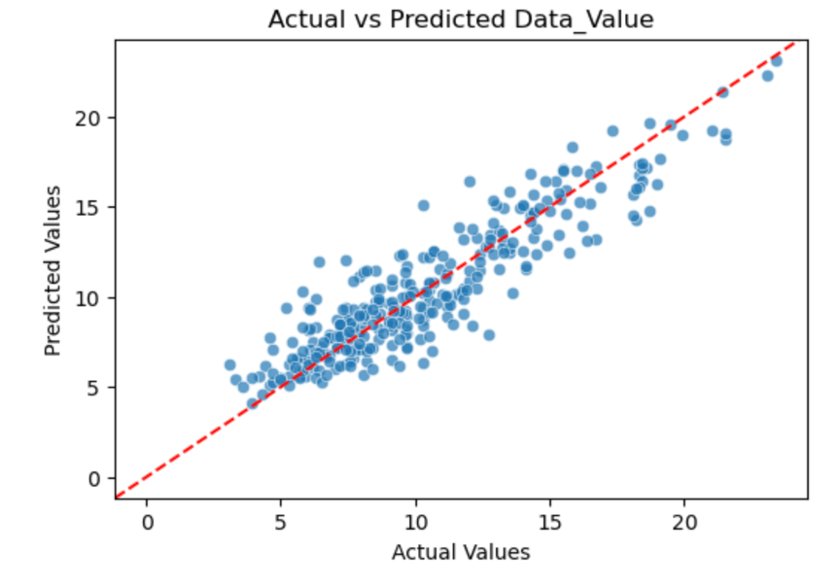
Visual: Scatter plot comparing actual versus predicted percentage values of frequent mental distress among older adults.

Slide 12
Conclusion & Future Work
Conclusion:
Geographic Insights:
Future Steps:
This project successfully built a fairly accurate predictive model for frequent mental distress among older adult women using survey data. Self-perceived health, physical activity, caregiving roles, and income level emerged as strong, multi-dimensional predictors.
Incorporating geographic patterns revealed disparities that can inform region-specific interventions.
Validate the model on a broader and more diverse dataset.
Explore time trends across multiple years to understand FMD evolution.
Investigate the impact of other factors like social determinants of health.

Slide 13
Tools & Technologies
Programming Language:
Visualization Libraries:
Machine Learning Libraries:
Matplotlib,
Seaborn
Scikit-learn,
XGBoost
Python (pandas, numpy, scikit-learn)

Slide 14
Thank You & Q&A
Thank you for your time and attention.
I'm now happy to answer any questions you may have.

